Slide 1
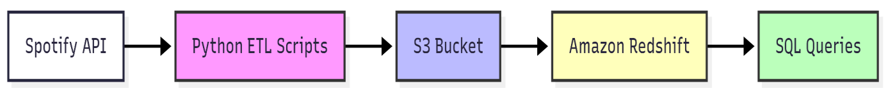
CAPSTONE PROJECT REPORT
Spotify Data Engineering Pipeline
1. Introduction
The objective of this project was to design and implement a cloud-based data pipeline for Spotify data. The pipeline demonstrates core data engineering concepts including data extraction, transformation, loading, and analytics.
By leveraging the Spotify API, Python (ETL scripts), Amazon S3, and Amazon Redshift, the project establishes a robust process to handle real-world music data at scale.
The final deliverables include a functioning data warehouse in Redshift, an Entity Relationship Diagram (ERD), SQL-based analytics, and insights from the dataset.
Architecture
The architecture follows a modern ETL (Extract–Transform–Load) pattern:
  Spotify API → Data is extracted using Python scripts and Spotify SDK.
  ETL with Python → The data is cleaned, transformed, and saved as JSON/CSV.
  Amazon S3 → Raw and transformed files are stored as an intermediate data lake.
  Amazon Redshift → Data is loaded into warehouse tables using COPY commands.
  SQL Analytics → Queries in Redshift generate insights about artists, albums, and
tracks.

Slide 2
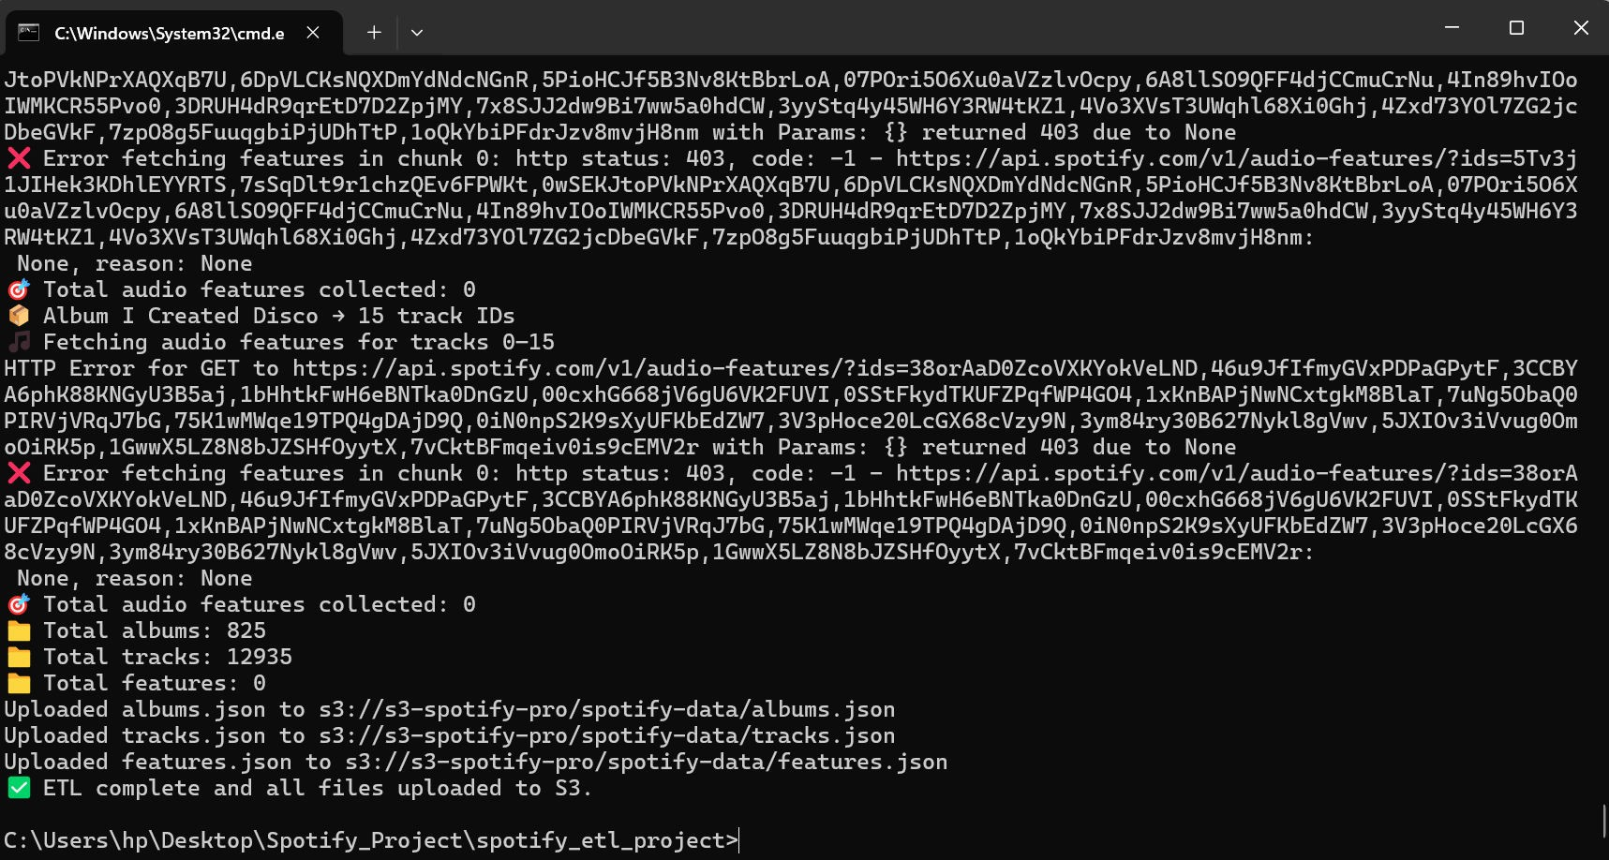
Data Extraction
The extraction step was performed using a Python ETL script (spotify_etl.py).
  The script uses Spotify’s Web API with Client Credentials flow for authentication.
  Data collected:
    Top 200 artists (with id, name, followers, popularity, genres)
    Albums for each artist (id, name, release_date, total_tracks)
    Tracks for each album (id, name, duration_ms, explicit, track_number, duration_minutes)
  Data was written to local JSON and then uploaded to Amazon S3.

Slide 3
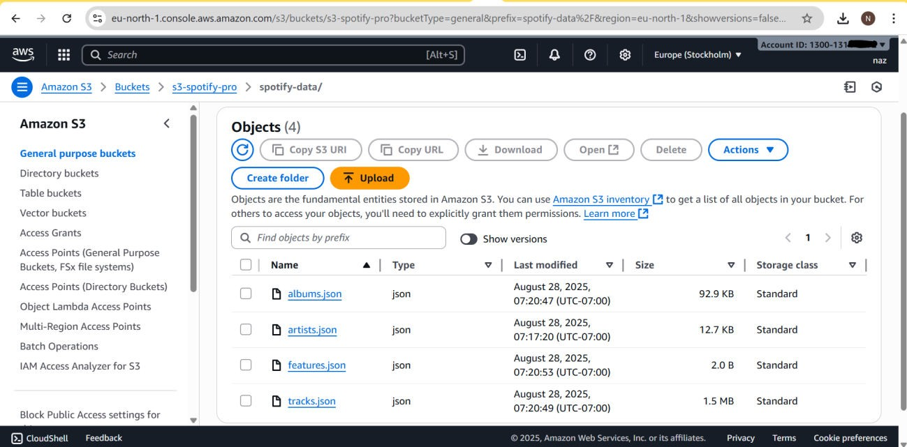
Data Transformation
Transformation was handled using Pandas (spotify_transform.py). Steps included:
  Cleaning missing values.
  Creating derived columns such as duration_minutes.
  Generating aggregated datasets:
    album_counts.csv → number of tracks per album.
    avg_durations.csv → average track duration per album.
  Final output files: artists.csv, albums.csv, tracks.csv, album_counts.csv, avg_durations.csv.
  All files were stored in S3 under s3://s3-spotify-pro/output/.

Slide 4
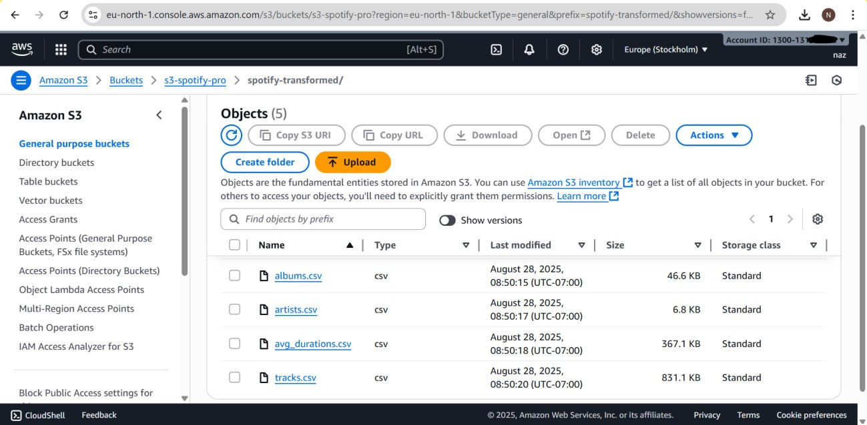
Data Loading
Data was ingested into Amazon Redshift using the COPY command. Example:
COPY spotify.artists
FROM 's3://s3-spotify-pro/output/artists.csv'
IAM_ROLE 'arn:aws:iam::<1300131******>:role/RedshiftS3AccessRole' CSV IGNOREHEADER 1;
  Tables created: artists, albums, tracks, album_counts, avg_durations.
  Data was successfully loaded into Redshift, with the following counts:
    artists → 200 rows
    albums → ~2,469 rows
    tracks → ~38,745 rows
    album_counts → ~2,460 rows
    avg_durations → ~21,070 rows

Slide 5
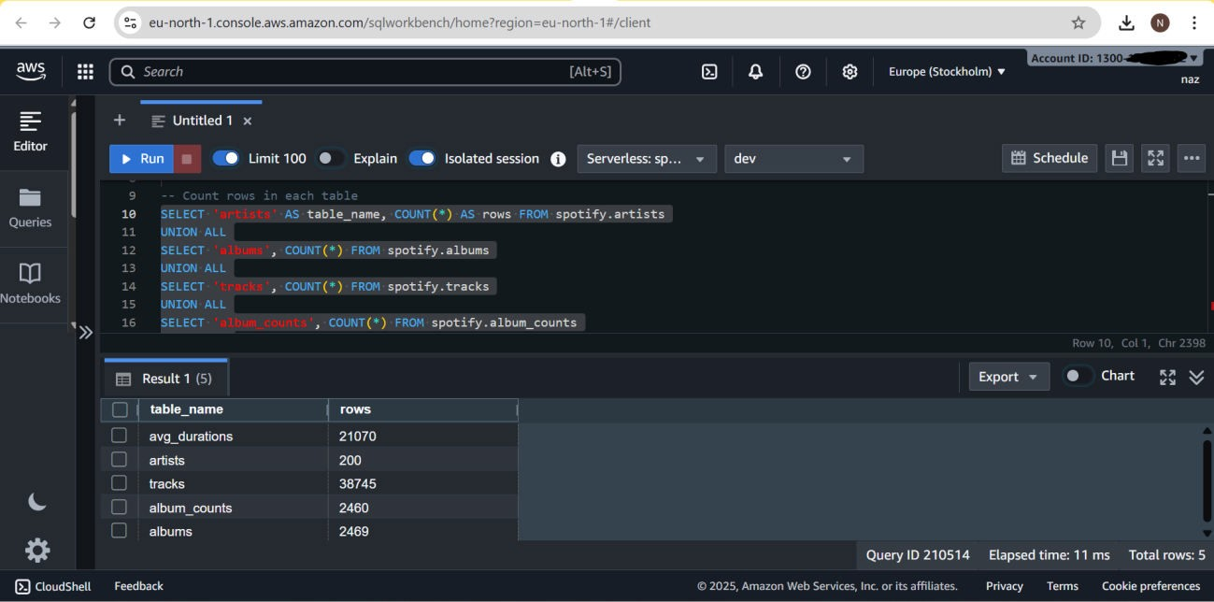
Entity Relationship Diagram (ERD)
The ERD reflects the main tables in Redshift.
  artists contains metadata about artists.
  albums contains album-level data.
  tracks contains track-level data.
  album_counts and avg_durations are pre-aggregated helper tables.
Since the Spotify API extraction did not include explicit artist_id → album_id → track_id
relationships, the tables remain independent.

Slide 6
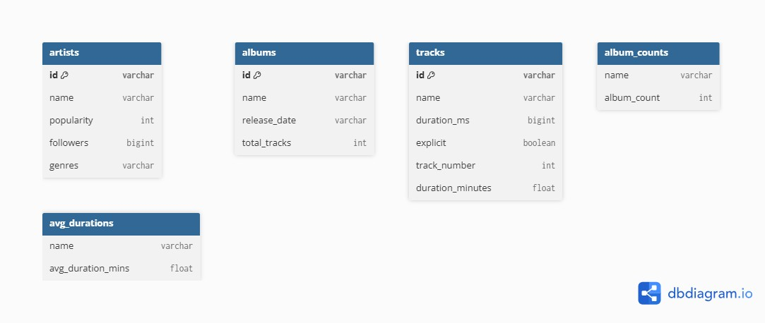
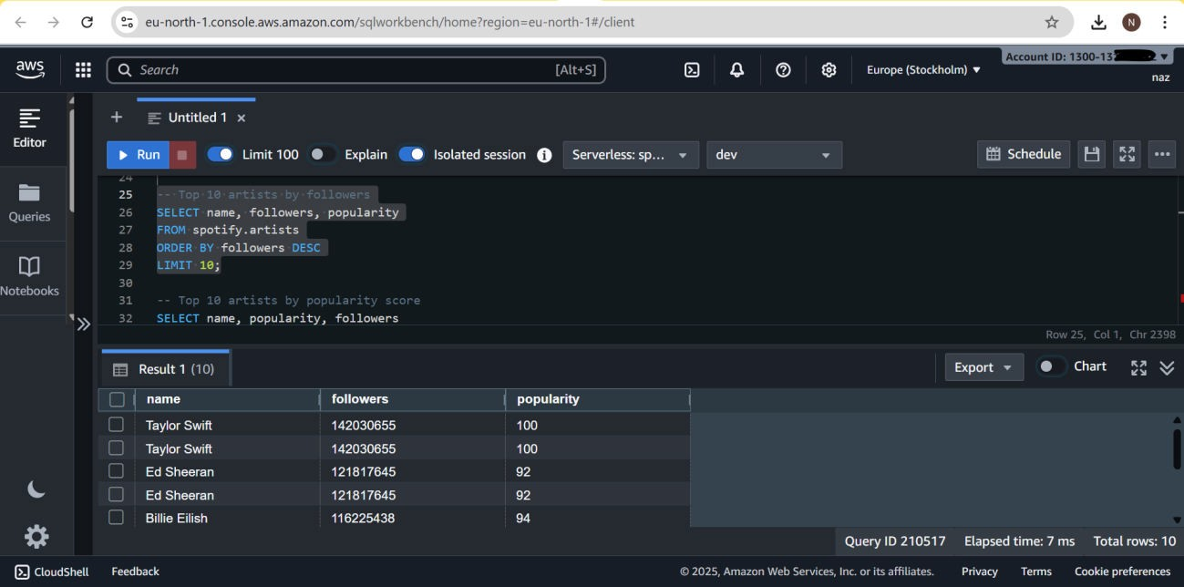
7. Analytics & Queries
A series of SQL queries were run in Redshift Query Editor v2 to extract insights:
1. Top 10 Artists by Followers
SELECT name, followers, popularity FROM spotify.artists
ORDER BY followers DESC LIMIT 10;

Slide 7
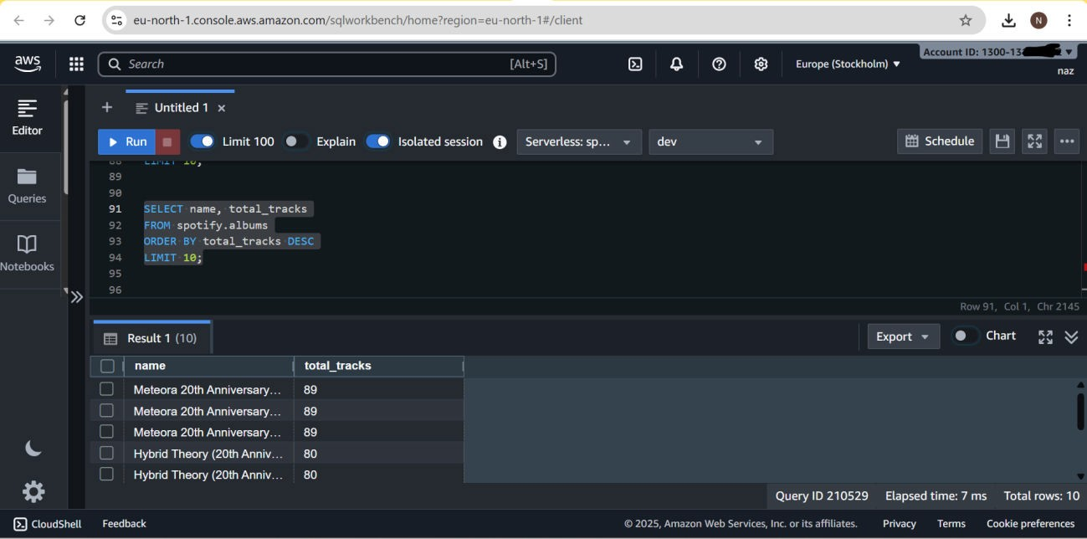
2. Albums with the Most Tracks
SELECT name, total_tracks FROM spotify.albums ORDER BY total_tracks DESC LIMIT 10;
3. Shortest and Longest Tracks
SELECT name, duration_minutes FROM spotify.tracks
ORDER BY duration_minutes ASC LIMIT 10;

Slide 8
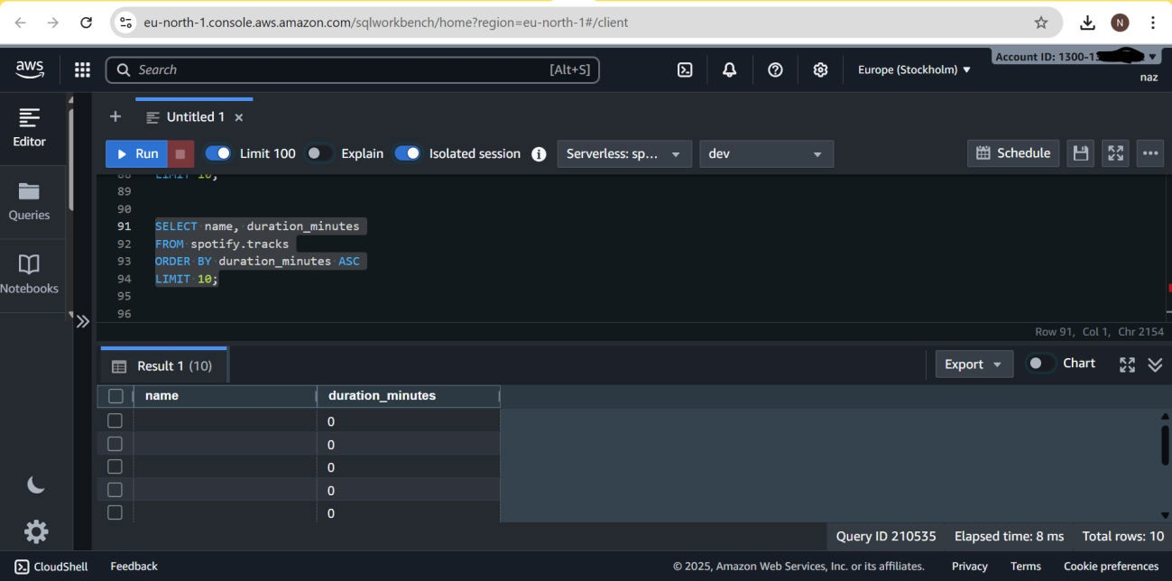
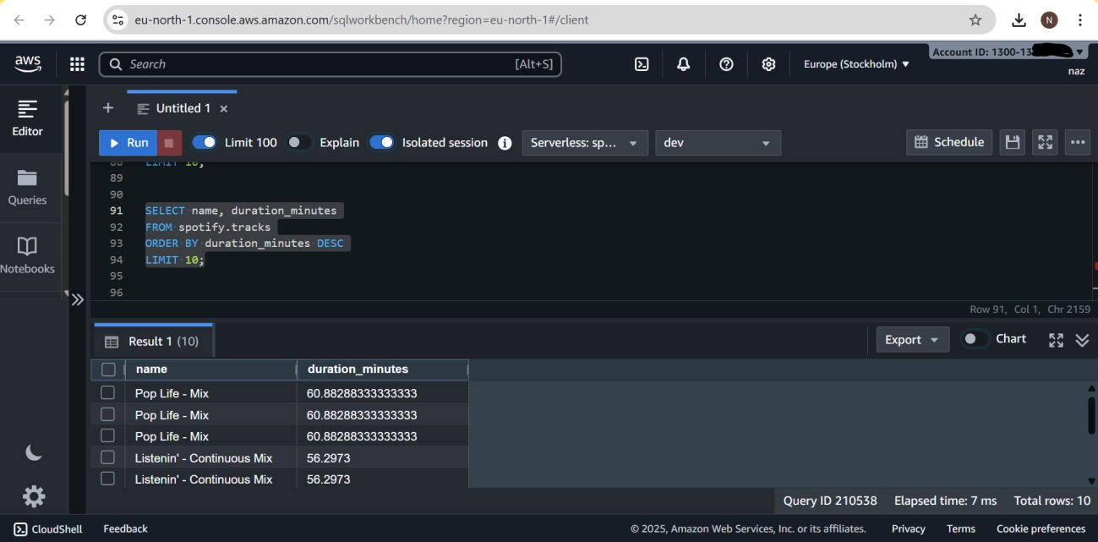
SELECT name, duration_minutes FROM spotify.tracks
ORDER BY duration_minutes DESC LIMIT 10;
4. Average Song Duration Overall

Slide 9
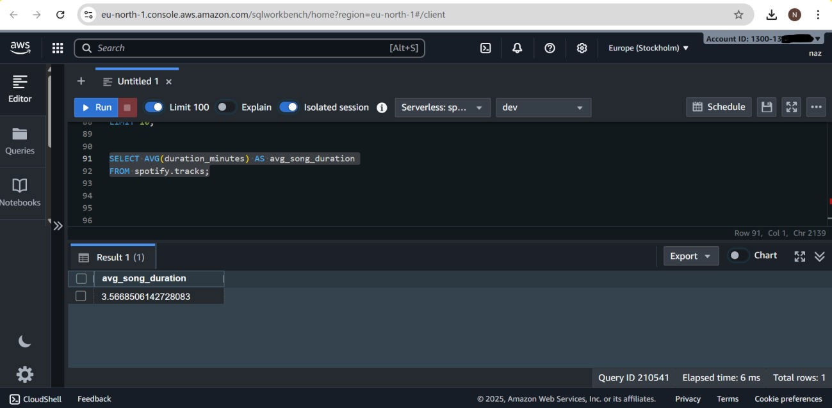
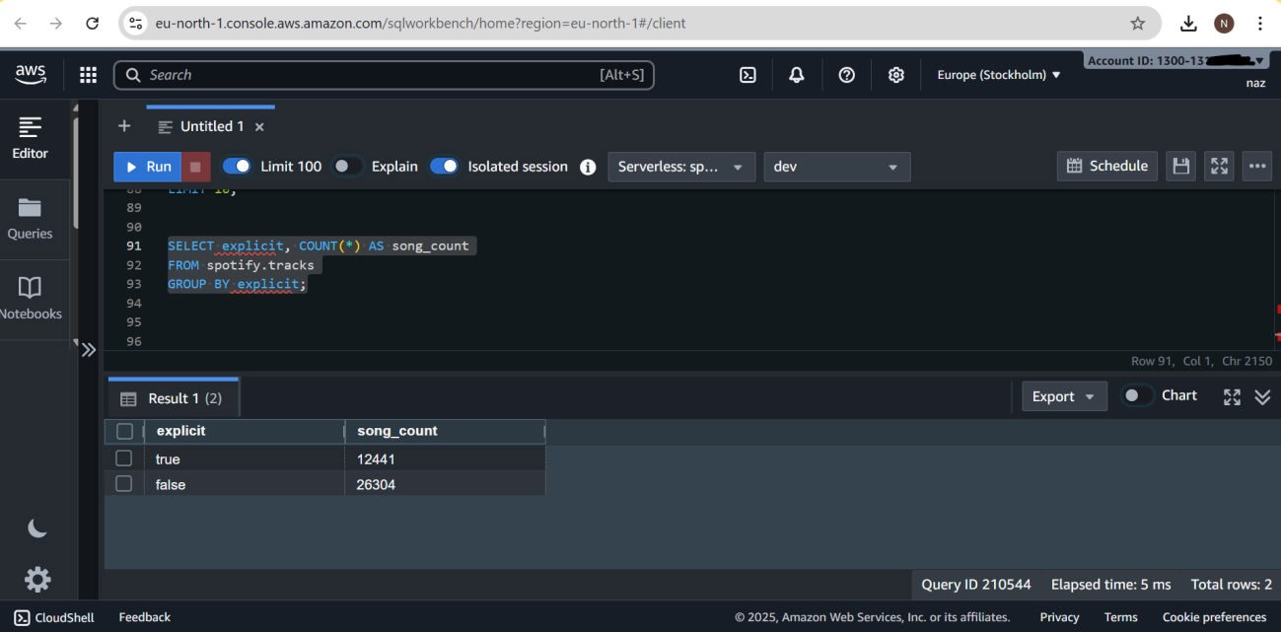
SELECT AVG(duration_minutes) AS avg_song_duration FROM spotify.tracks;
5. Explicit vs Non-Explicit Tracks
SELECT explicit, COUNT(*) AS song_count FROM spotify.tracks
GROUP BY explicit;

Slide 10
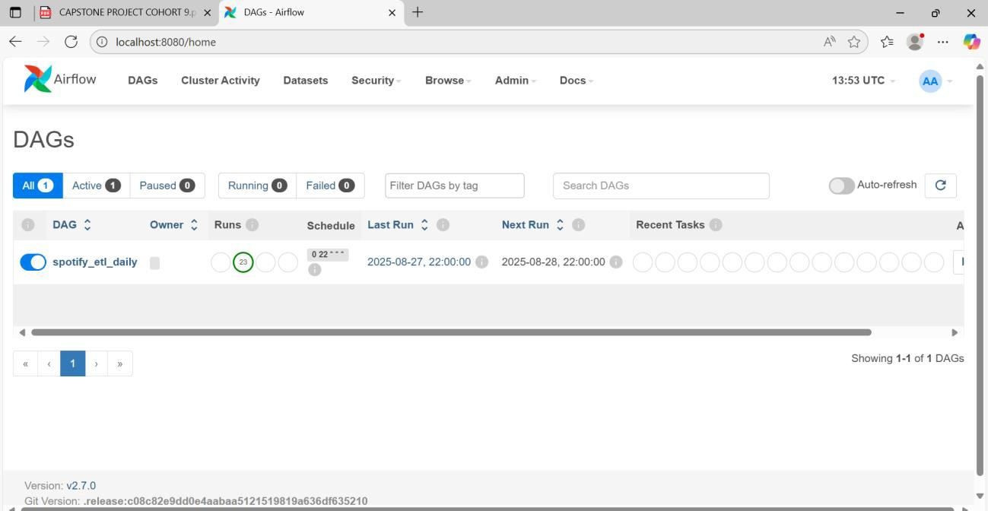
Scheduling with Airflow
The Spotify ETL pipeline was scheduled using Apache Airflow to automate daily ingestion of raw data into Amazon S3.
  A custom DAG (spotify_etl_dag.py) was created in Airflow.
  The DAG runs the Python ETL script (spotify_etl.py) every day at 10 PM using a CRON schedule (0 22 * * *).
  This ensures the pipeline continuously fetches and updates the dataset without manual intervention.

Slide 11
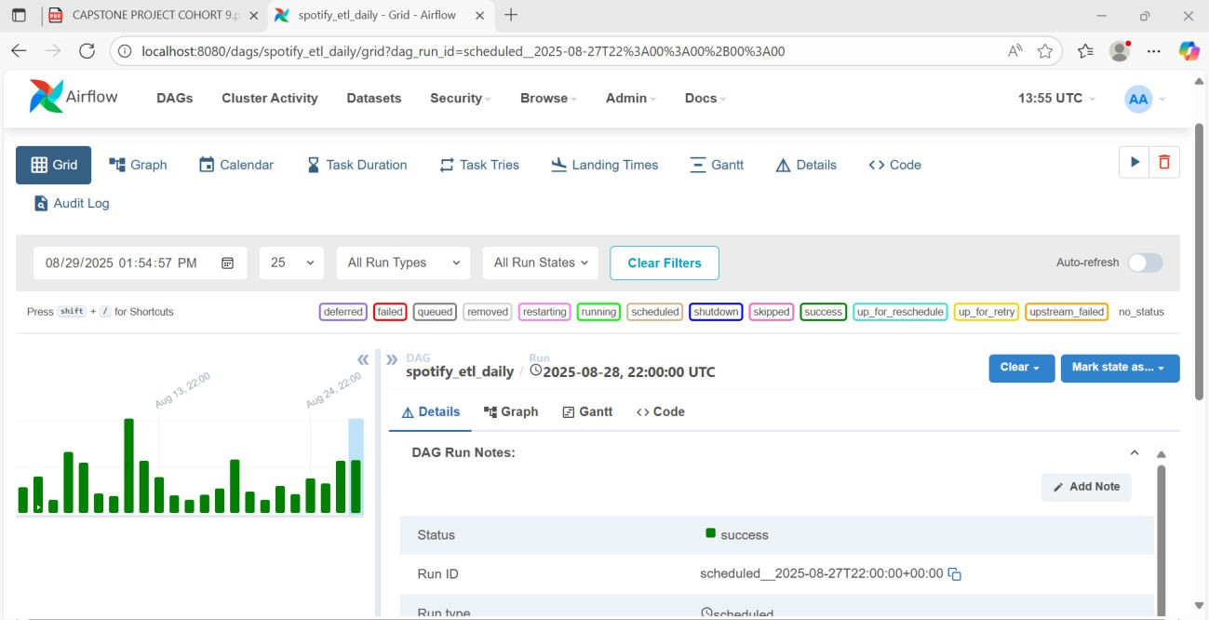
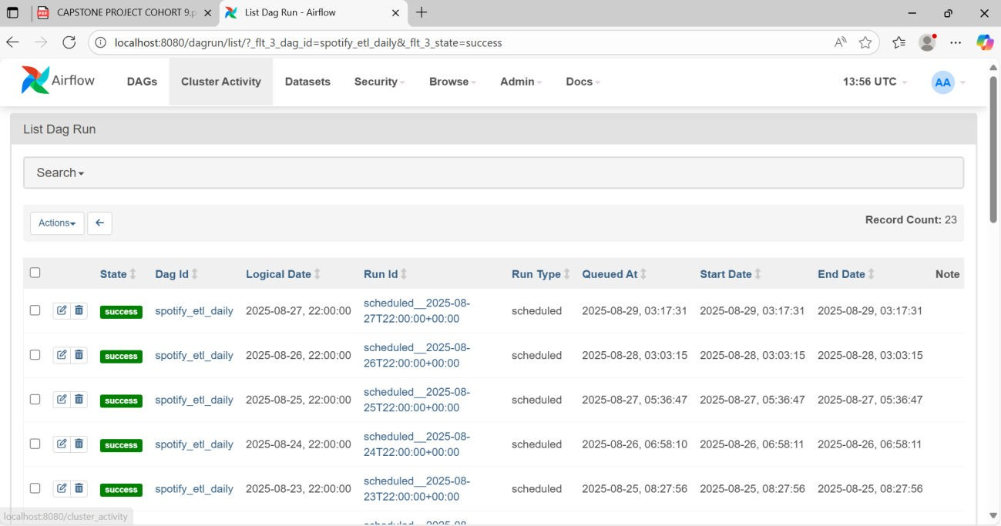
Conclusion
This project successfully demonstrated a complete data engineering pipeline using:
  Spotify API for data extraction

Slide 12
Python (Spotipy + Pandas) for ETL
Amazon S3 as a staging data lake
Amazon Redshift as the cloud data warehouse
SQL analytics for insight generation
Key findings include:
The dataset included 200 artists, 2,469 albums, and 38,745 tracks.
The most followed artists had millions of followers, showing global popularity trends.
Song lengths varied widely, with an average duration of around 3–4 minutes.
A notable percentage of tracks were flagged as explicit, showing cultural variations in content.
This project highlights the power of combining cloud data infrastructure with modern ETL tools to build scalable analytics pipelines.

